Slide 1




1-10 Fines
Enforcement in Traffic Safety
05.13.2025

Slide 2
What is the law?
MPH Over | Fine | Demerit Point
1-10 | $100 | 1
11-20 | $150 | 2
21-30 | $200 | 3
31+ | $300 | 4 (5 if 41+)
Too Fast For Conditions | $200 | 2
Reckless Driving (Wanton Disregard) | $1,000 | 8
Impeding Traffic | $200 | 2

Slide 3
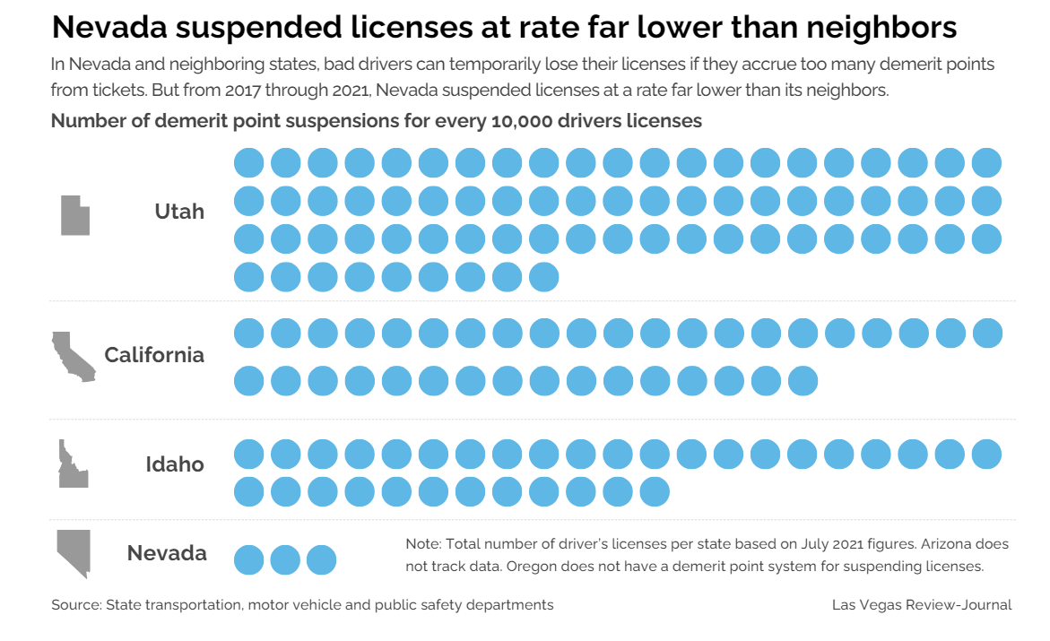

Slide 4

The Third “E” in Traffic Safety

Slide 5
Enforcement…
Legislation
Enforcement
Prosecution
Adjudication

Slide 6

Legislation

Slide 7
AB116
Effective: January 1, 2023
Purpose: To decriminalize “minor” traffic offenses, converting them from misdemeanors to civil infractions.
Scope: Applies to “minor” traffic violations such as speeding, running a stop sign, etc.
Penalties: Includes fines but no criminal record or jail time.
Social Impact: Minimizes the risk of escalating “minor” infractions into criminal justice involvement.

Slide 8
AB116 Criminal Traffic Offenses
Driving w/out valid license
Driving cancelled, revoked, or suspended
Driving while epileptic
Permitting unlicensed minor to drive
Refusal/failure to comply with lawful order of peace office enforcing 484A to 484E
Driving upon sidewalk
Following too closely
Permitting unlicensed minor to drive
Refusal/failure to comply with lawful order of peace office enforcing 484A to 484E
Driving upon sidewalk
Following too closely
Criminal offense in work zone is subject to double criminal penalty
Criminal offense in pedestrian safety zone is subject to double criminal penalty
Drinking alcohol while driving or open container
Child restraint
Driving w/out valid license
Driving cancelled, revoked, or suspended
Driving while epileptic

Slide 9
AB116 Criminal Traffic Offenses
Failure to yield to emergency vehicle
Walking along or upon highway, hitchhiking, soliciting business or a contribution along highway, or intoxicated pedestrian
Attempt to/or alter traffic signs and signals
Devices to interfere with traffic signals
Refusal/failure to comply with signals of authorized flagger resulting in damage to property not less than $1,000
Failure to obey school crossing guard
Overtaking or passing school bus
Handicapped parking
Failure to stop upon signal of a peace officer
Failure to stop at a roadblock
Biking or walking on restricted use highway
Speeding 30 mph or more over limit (damage to person/property resulting from speeding carries a $1,000 civil penalty)
Failure to take certain actions when approaching an accident
Aggressive driving, also driver may be prosecuted for aggressive driving whether or not a civil citation is issued or the person is found to have committed a civil infraction
Reckless driving, speed contests, or trick driving
Vehicular manslaughter
Permit required for parade, sound trucks, or oversized vehicles
Driving under the influence (DUI) (Penalties: 484C.400 to 484C.440)

Slide 10
AB116 Criminal Traffic Offenses
Commercial DUI (Penalties: 484C.400 to 484C.440)
DUI vehicular homicide
Failure to return license, registration or license plate
False or forged insurance documents or misrepresentation of documents
Permitting an unlicensed person to drive a motorcycle
Failure to install interlock device
Providing breath sample for another (interlock)
Odometer fraud
Event recording devices (car “black boxes”)
Failure/refusal to stop and submit to safety inspection
Failure/refusal to stop and submit to a weighing
Failure to stop at scene of crash and remove traffic obstruction (vehicle)
Failure to provide information or render aid after crash
Failure to leave contact information after crash with unoccupied vehicle
Failure to notify law enforcement after crash with unoccupied vehicle
Knowingly providing false information in a crash report
Unlawful acts related to motor vehicle liability insurance
Operating motor vehicle when license or registration is suspended

Slide 11

Enforcement

Slide 14
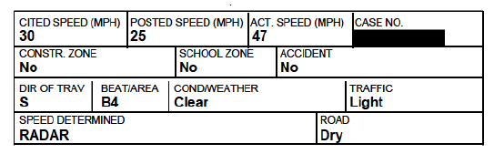

Slide 15
Prosecution &
Adjudication

Slide 16
